Slide 1
Wishlist-it
Product Tracker

Slide 2
Concept
Track Products
Homepage
Create a product and add it to dashboard list.
Create an account
Login
Redirect to dashboard
Create a wishlist to track items
Dashboard
Set Product Info
User is able to set prices, add product notes, images, quantity.
See products based on user id.
Add Items to list.
Sort by category.

Slide 3
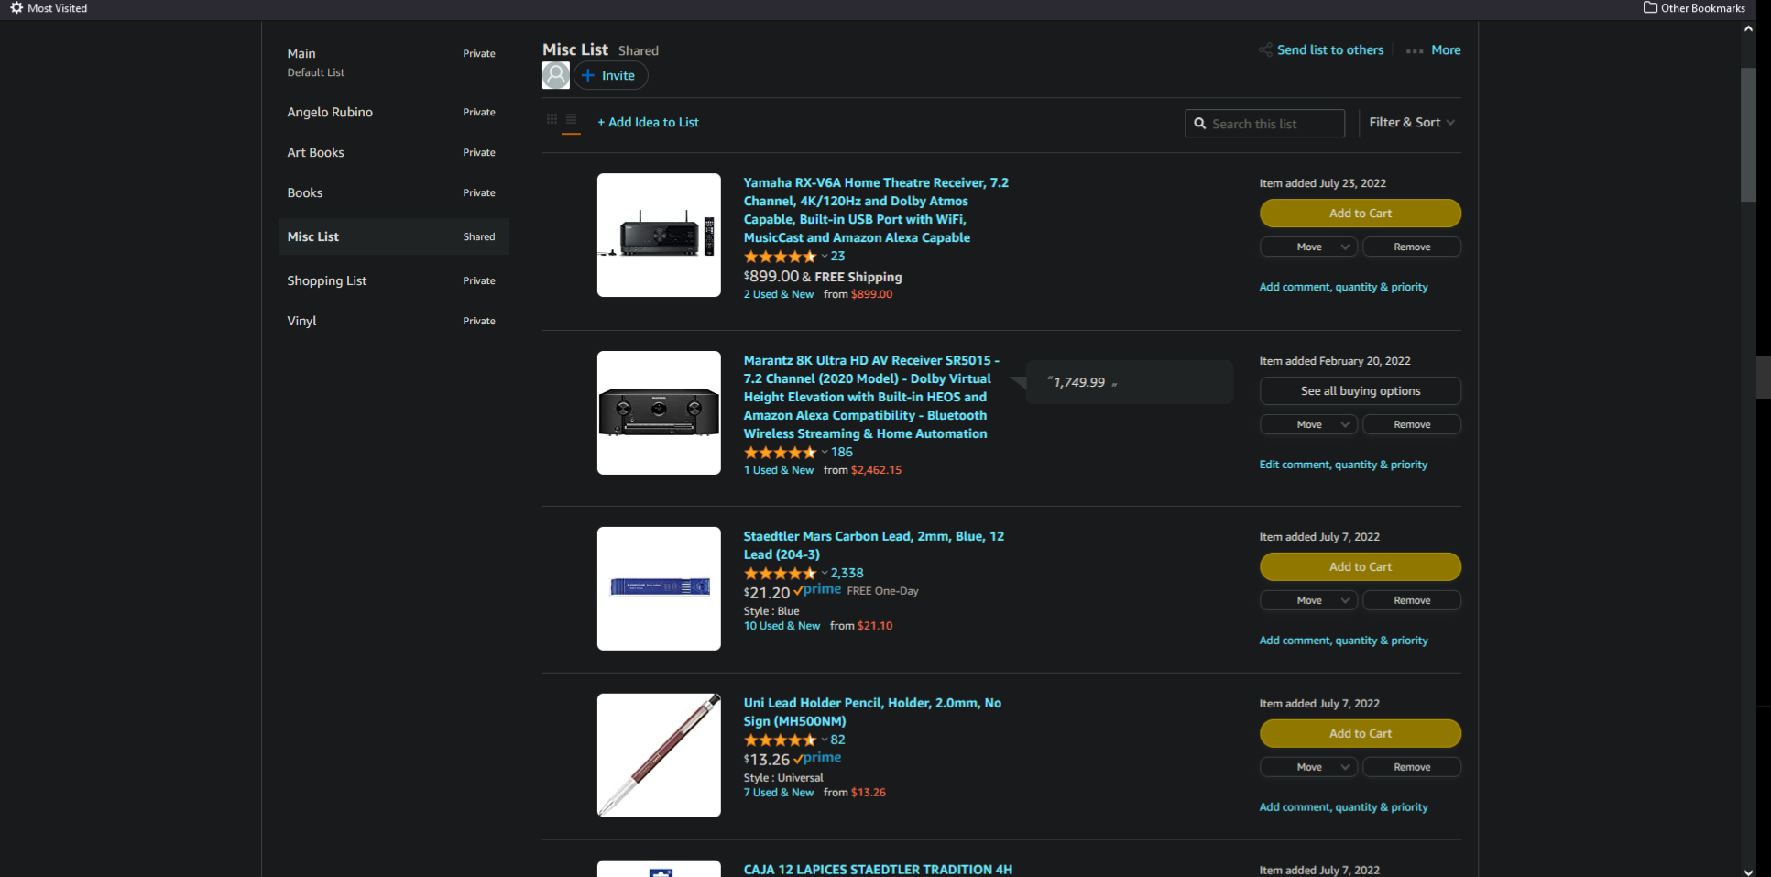
Inspiration

Slide 4
Technologies
1
Node.js & Express
6
New Tech
Heroku & JawsDB
Google OAuth
2
5
SQL & MySQL 2
Handlebars.js
3
4
Jest
Express-session

Slide 5
Project Roles
Arjun Sharman
Umer Farooq
Back-End API Routes
Models
Login Page
Merge Conflicts
Google OAuth
Front-End
Wireframes
Design
Daniel Rubino
William Chow
Back-End API Routes
Models
Documentation
Merge Conflicts
Heroku deployment
Front-End
Dashboard Design
Product Images
Handlebars

Slide 6
Challenges & Successes
Teamwork
Using Branches
Review Process
Division of work
Working on features in specific branches before merging.
Using branch protection and making use of pull request reviews.
Schedule
Communication
Troubleshooting
Working with different schedules.
Keeping everyone up-to-date on progress.
Fixing merge conflicts / Getting things to work.

Slide 7
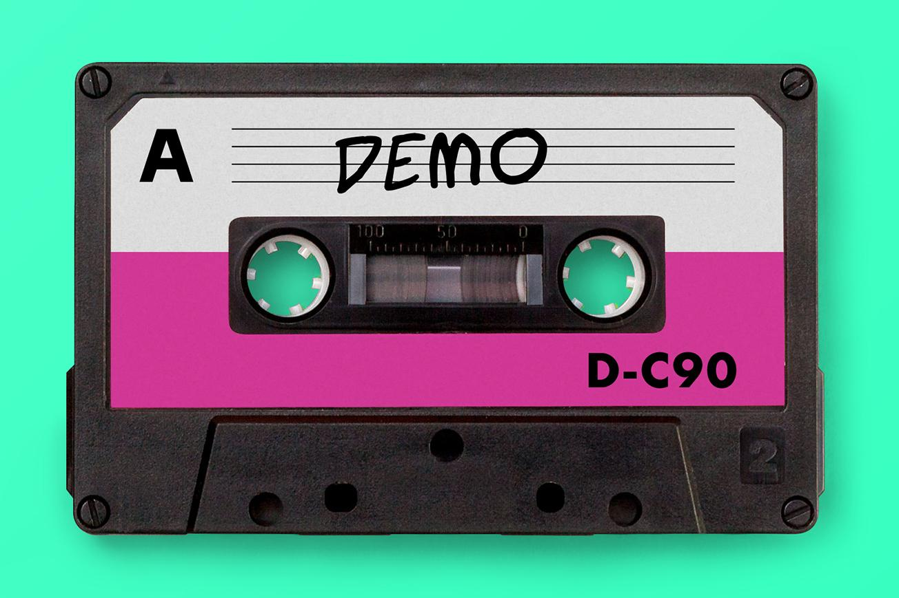

Slide 8
Future Deployment
NOW
FUTURE
1
Add products to list.
Send notifications about price changes.
1
2
Set product information.
Track product prices based on user’s set e-commerce site.
2
3
Sort products by category.
The ability to send created lists to an email address.
3

Slide 9

Deployed App / GitHub
Heroku: https://vast-depths-33526.herokuapp.com/
GitHub Repository: https://github.com/RubinoD1/Wishlist-it-product-tracker

